Slide 1
How to Order Your Textbooks
Visual Instructions

Slide 2
Before you begin, please have your Owens class schedule available. An example is located here.

Slide 3
Bookstore Website
The Owens Community College Bookstore is now located virtually. Please go to the following website to order your textbooks.
www.bkstr.com/occstore/home

Slide 4
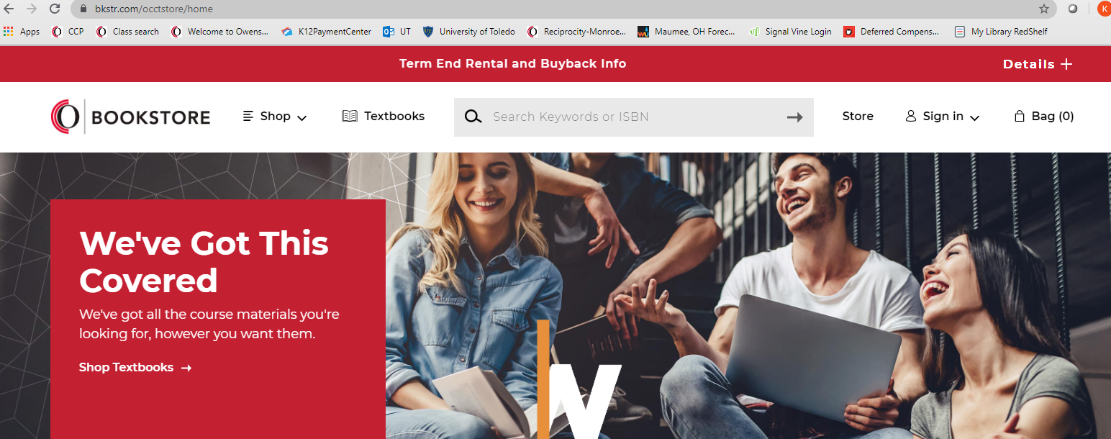
Click ‘Shop’ or ‘Textbooks’ to get started

Slide 5
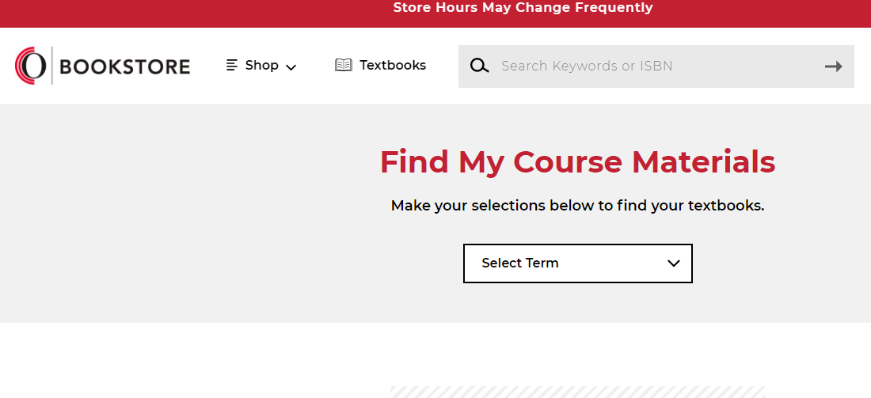
Select the term you are searching from the drop down menu

Slide 6
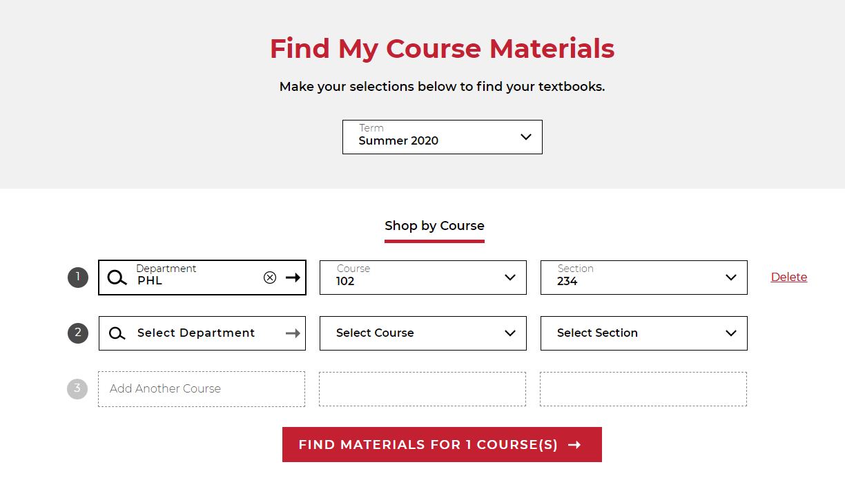
Refer to your class schedule to complete the ‘Shop by Course’ section. An example has been provided as a reference below. Note: You can search for multiple classes at one time.

Slide 7
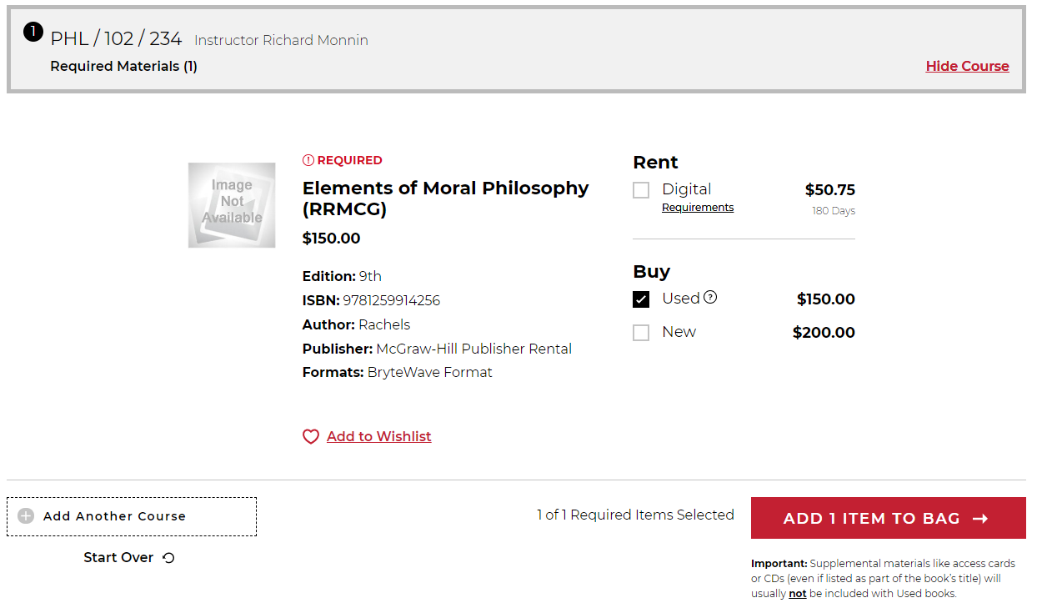
Select what book you are purchasing and then click ‘ADD 1 ITEM TO BAG’

Slide 8
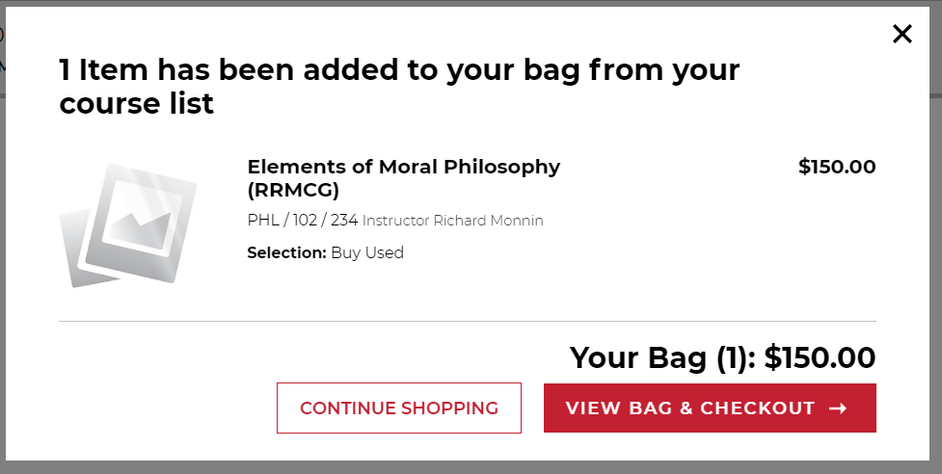
Your item will be displayed. You can then choose to proceed to checkout or continue to shop.

Slide 9
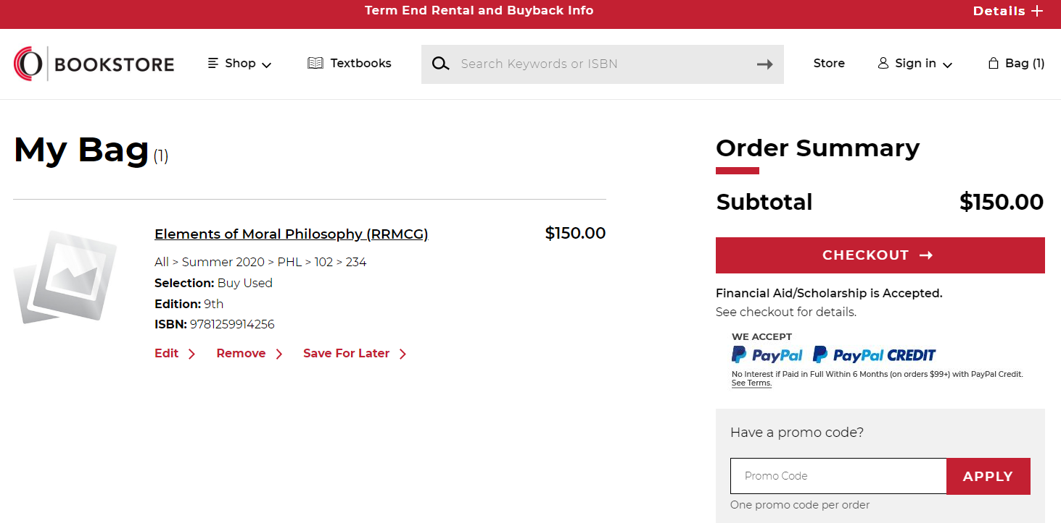
Once done selecting your items to purchase you will want to view your items that are in your cart. If correct, click on ‘CHECKOUT’.

Slide 10
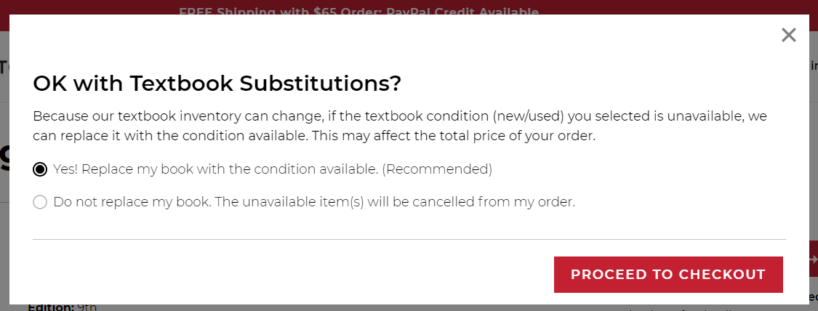
Select the option you prefer and then click ‘PROCEED TO CHECKOUT’

Slide 11
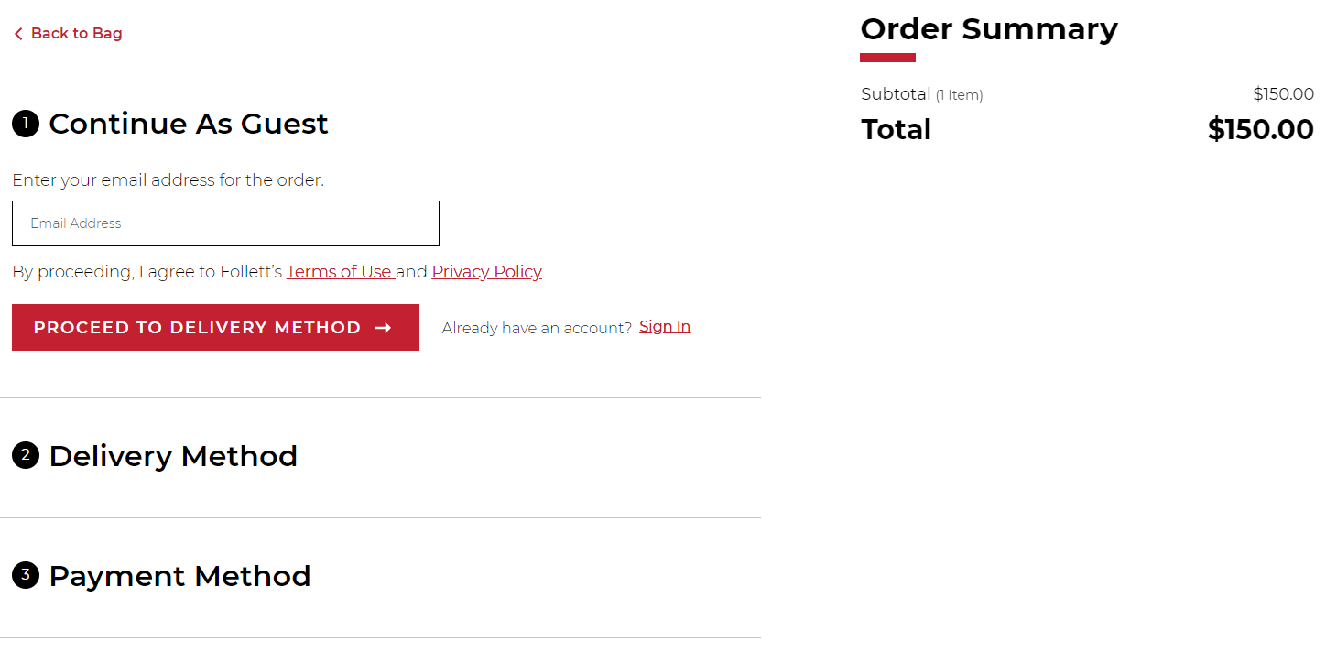
It is best to create an account so that your information can be saved for a faster checkout of any future bookstore purchases you may need to make. If you do not want to create an account, click on ‘Continue as Guest’ and enter your Owens student email address. Once finished, click on ‘PROCEED TO DELIVERY OPTIONS’.

Slide 12
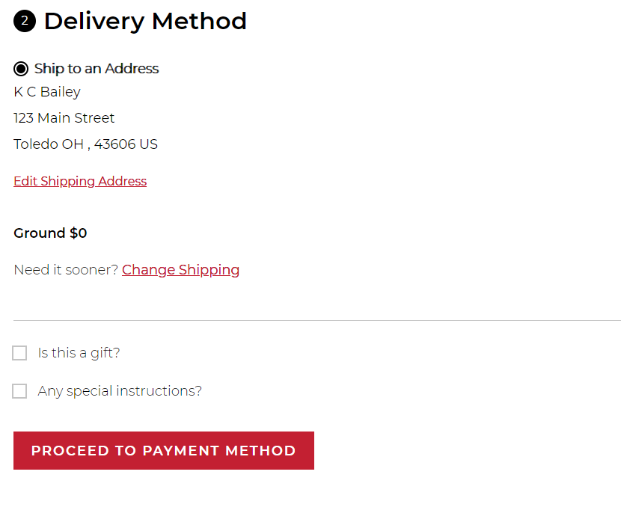
Enter the address you want your order shipped to. Then click on ‘PROCEED TO PAYMENT METHOD’.

Slide 13
There are three different payment options available: Book Vouchers Credit/Debit or Gift Cards PayPal The next two slides provide additional details on the payment options. Select the option that best applies to you.
Payment Options

Slide 14
Book Voucher Payment Methods
Financial Aid Book Vouchers
Click on Financial/Scholarships and enter your OCID. Your OCID can be found on your Ozone account under the ‘My Ozone’ tab. OCIDs start with 84 and will be 9 numbers long. Once entered, click on ‘FIND ACCOUNTS’.
CCP or Third Party Book Vouchers
Click on Financial Aid/Scholarships, and your book voucher will display if you are eligible. Click on the small box to agree to terms and then click on ‘PAY WITH THIS’.

Slide 15
Credit/Debit or Gift Card Payment Methods
Gift Cards
Up to four different gift cards can be entered. The Account Number is the 16 digits found on the gift card, and the PIN number will be 4-digits. The Account Number will need to be entered with NO spaces.
Credit/Debit Cards
Type in the information as it is displayed on the credit/debit card. Once entered another screen will pop up to enter the CVC number (3-digit number found on the back of card). Confirm the billing address and update as necessary.

Slide 16
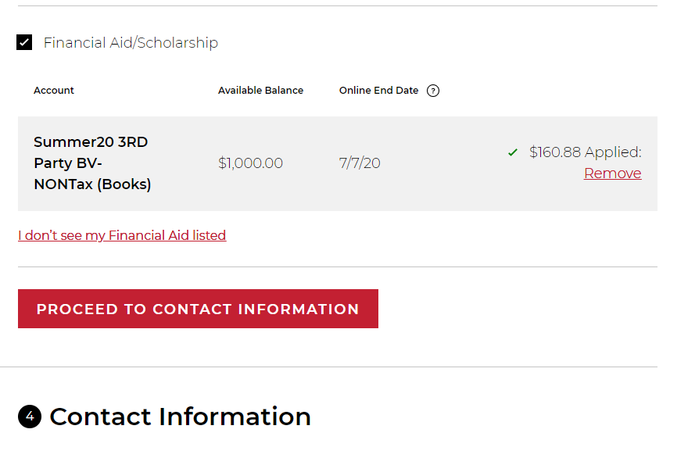
If everything looks correct, click on ‘PROCEED TO CONTACT INFORMATION’

Slide 17
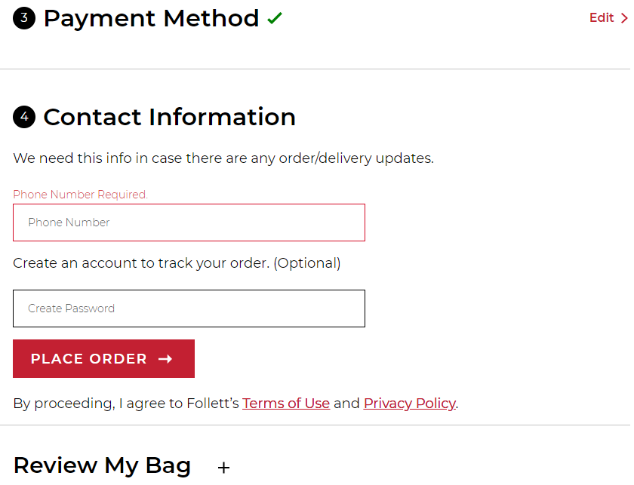
Enter your current phone number click on ‘PLACE ORDER’ to complete your purchase.

Slide 18
YOU’RE DONE!!
Once complete the next page will state ‘Thank You For Your Order’ and will include your order number and shipping details.
An order confirmation email will also be sent to the email address on file with the order. This should be kept as your form of receipt and provided if you encounter any issues with the delivery of your purchase.

Slide 19
Bookstore Contact Information
If you have questions, need assistance, or experience any issues with your order, please contact the bookstore and have your order number on hand.
PHONE: (800) 381-5151
EMAIL: occbookstore@bkstr.com

