Slide 1

College Credit Plus (CCP) at Owens

Slide 2



CCP eligibility
Three ways to qualify:
3.0+ unweighted high school GPA;
Eligible test scores (ACT, SAT, Accuplacer)
2.75-2.99 unweighted high school GPA and A or B in
  English 10 or higher
  Algebra I or II
  High School Chemistry
  Any AP or IB course

Slide 3

Placement testing
Useful for a couple reasons:
  General CCP eligibility
  May need test scores to take some classes
How can I test?
  At Owens: Call 567-661-8378 to schedule appointment
  At your high school: groups of 10+ can request an Owens proctor to test on-site

Slide 4
Steps to register at Owens
Complete CCP application
Meet with your high school counselor
  Counselor will confirm eligibility to participate
  Counselor sends necessary information to Owens
Schedule an appointment with your CCP advisor
  You can only register through your CCP advisor
Schedule with CCP Advisor:
https://www.owens.edu/collegecreditplus/staff/

Slide 5
Choosing CCP classes
High school counselor and CCP advisor can help choose classes
First 15 hours must be Level I classes
  For list of Level I classes, visit: https://www.owens.edu/collegecreditplus/downloads/
Things to consider when choosing:
  Will the class align with HS graduation requirements?
  Will this class be useful in my future degree program?

Slide 6

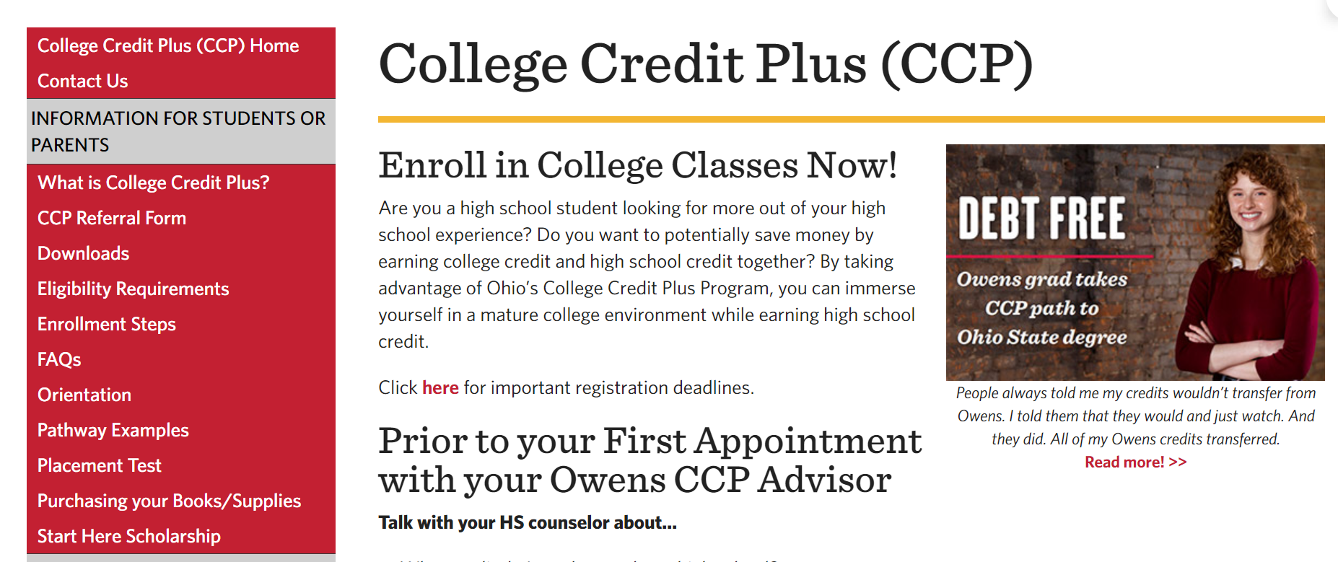
Owens CCP Website
owens.edu/collegecreditplus/
One-stop, useful information on Owens’s CCP program
Pay special attention to “Information for Students or Parents”

Slide 7
Benefits of CCP at Owens
Express Programs
  Rocket Express (UToledo)
  Falcon Express (BGSU)
  Oiler Express (University of Findlay)
Access to college facilities/services
  Library
  SHAC (fitness center)
  Tutoring services
  Career and Transfer Services
  Center for Campus and Community Connections
  On-campus events

Slide 8
Start Here Scholarship
Scholarship for students who attend Owens after graduating HS.
  $1,000 per semester, up to four semesters!
Requirements:
  9 credits of CCP in HS through Owens
  2.75GPA
  Full-time student after graduation

Slide 9
Your CCP team at Owens
Justin Hardman, Director of CCP
Brianna Albrecht, Assistant Director of CCP
Tyler Kish, CCP Advisor (Toledo)
Mikenzie Blunt, CCP Advisor (Toledo)

